Slide 1

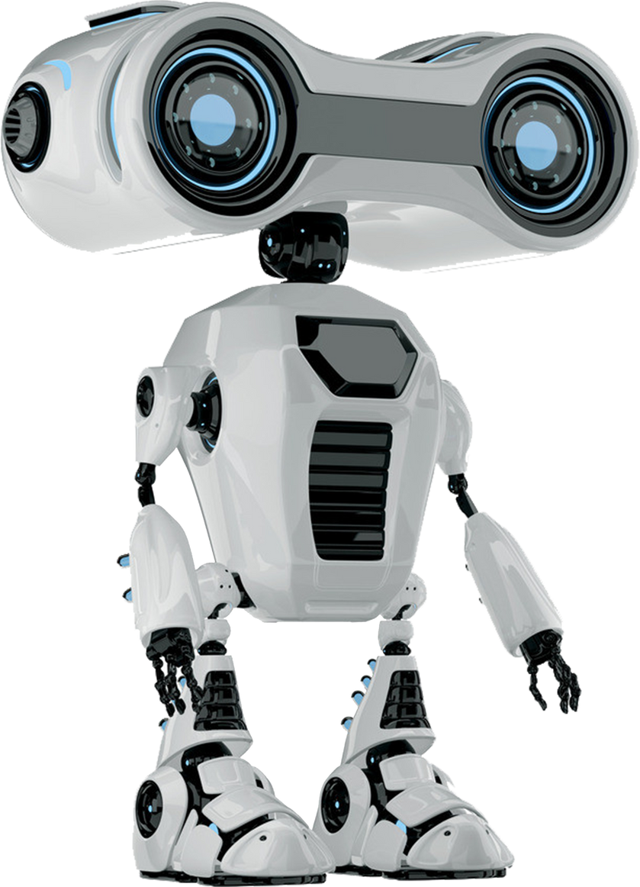

DIY RADAR SYSTEM
Subject:
Artificial Intelligence (AI)
Professor:
1.Chen Sovann
Team:
1.But Chomroeun
2.Chhouk Devidson

Slide 2



Project Overview
•This project simulates a RADAR system using an ultrasonic sensor mounted on a servo motor.
•The servo sweeps from 0° to 180°, detects objects, and sends data to Processing for visualization.

Slide 3



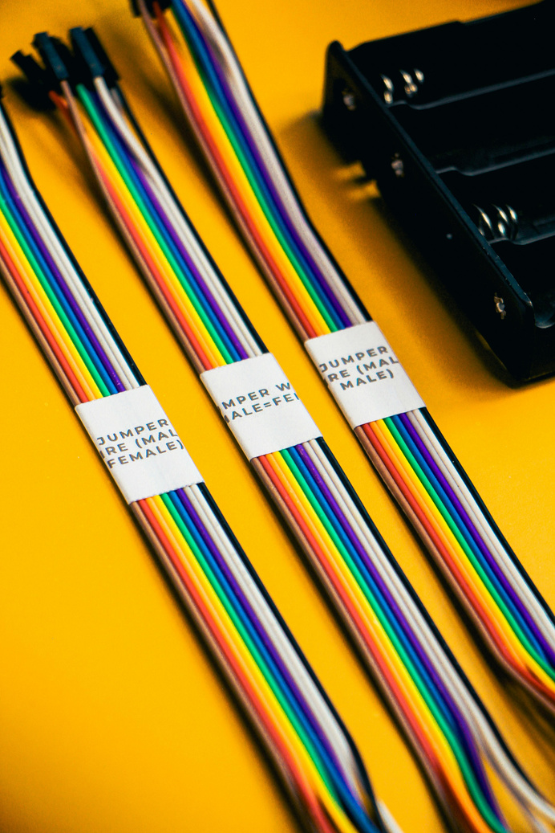
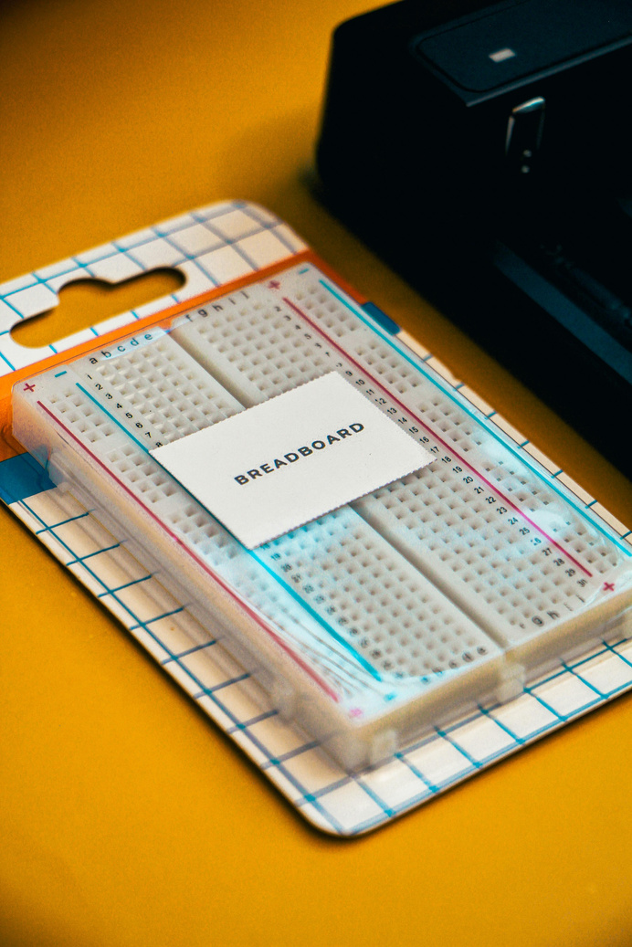
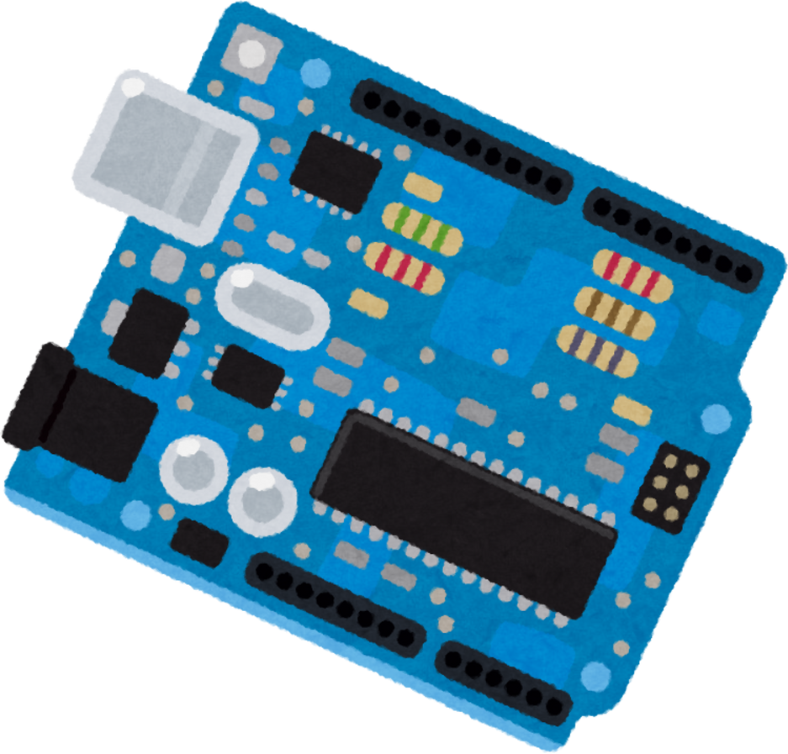
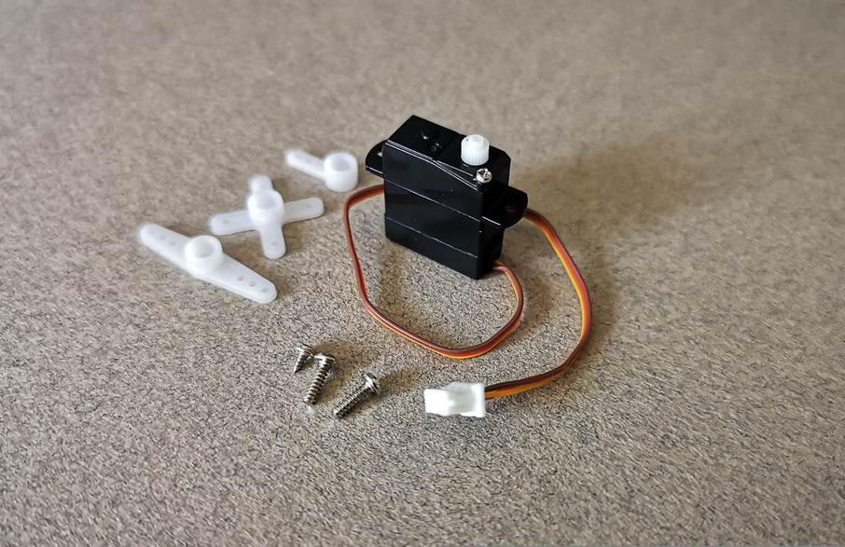
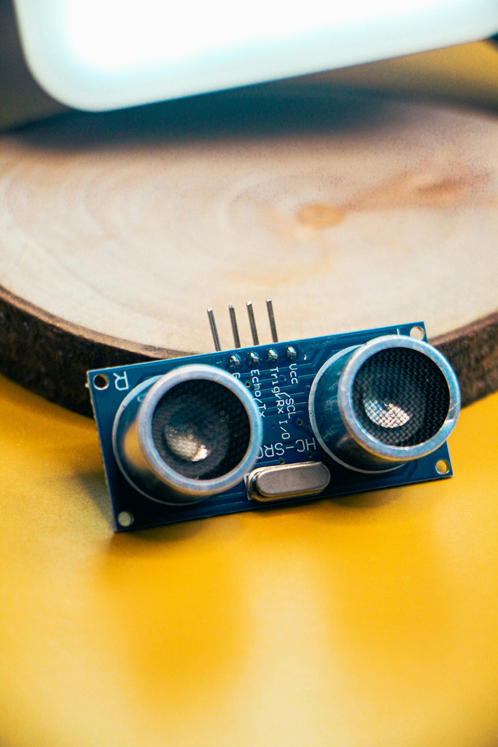

Components Used
PC
Jumper Wire
Breadboard
Arduino
Servo Motor (SG90)
Ultrasonic Sensor (HC-SR04)

Slide 4



Wiring Connection
Servo:
• Brown/Black → GND
• Red → 5V
• Yellow/Orange → D9
HC-SR04:
• VCC → 5V
• GND → GND
• TRIG → D10
• ECHO → D11

Slide 5


Arduino Code Logic
• Servo sweeps from 0° to 180°
• Ultrasonic sensor measures distance
• Servo stops if object is closer than 30 cm
• Angle and distance sent via Serial
• Smooth and slow rotation for visibility

Slide 6
Processing Visualization
• Receives angle & distance from Arduino
• Draws radar arcs and angle lines
• Displays detected objects with glow effect
• Shows live angle and distance values

Slide 7

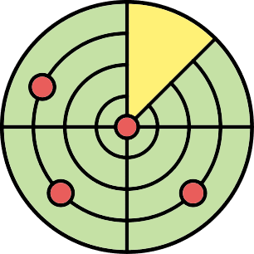
Result & Features
✔ Real-time RADAR-like display
✔ Object detection up to ~300 cm
✔ Servo auto-stops on detection
✔ Clear visual feedback on PC

Slide 8

Applications
• Arduino + sensor integration
• Object detection systems
• Robotics and automation basics

Slide 9

CONCLUSION
This DIY RADAR system demonstrates how Arduino, sensors, and software visualization can work together to create an interactive and educational project.

Slide 10

THANK YOU!

